Slide 1
Musical Instrument Classification
Presented by:
Zafeiriou Argiris
Zidianakis Matthaios

Slide 2
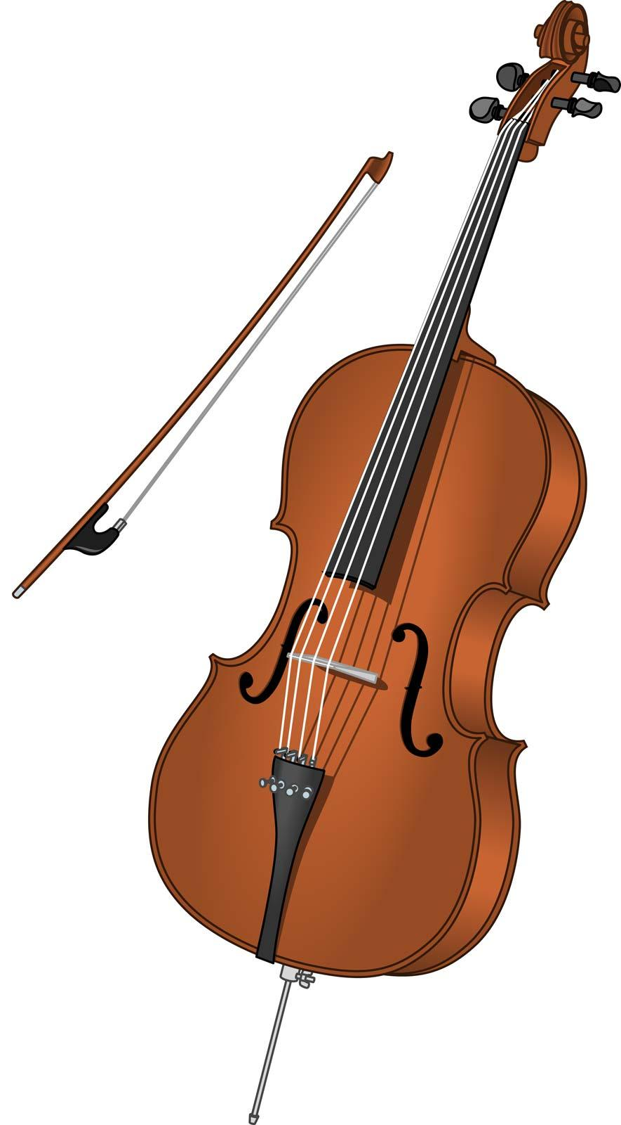
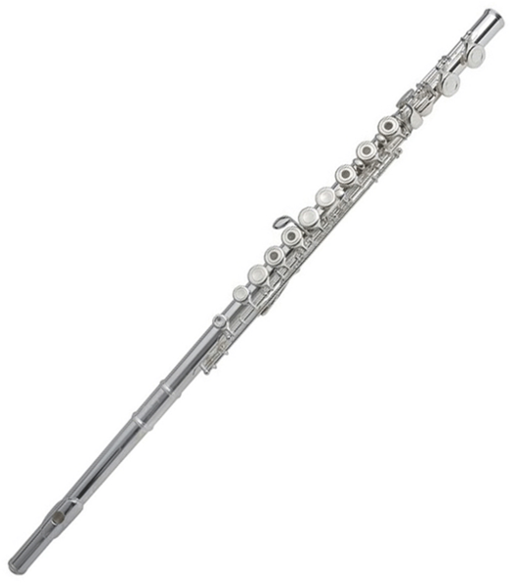
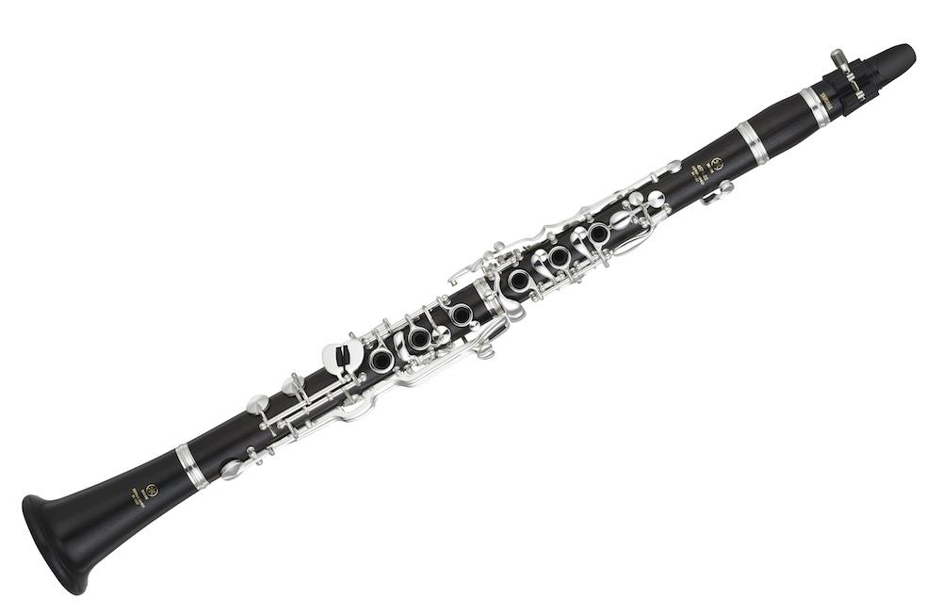
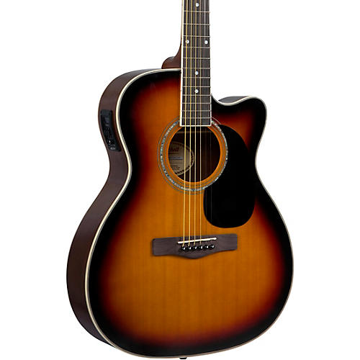
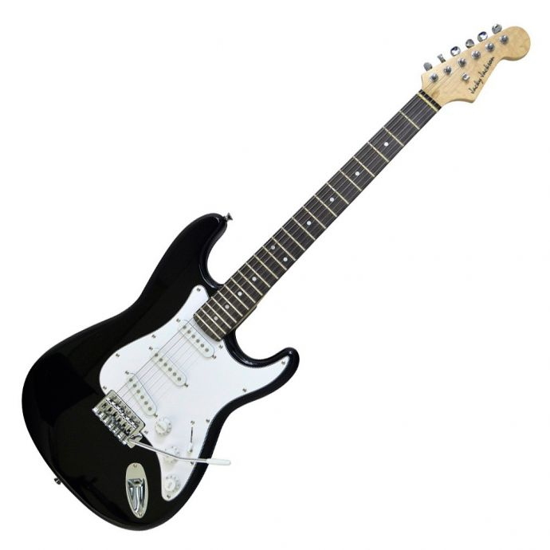
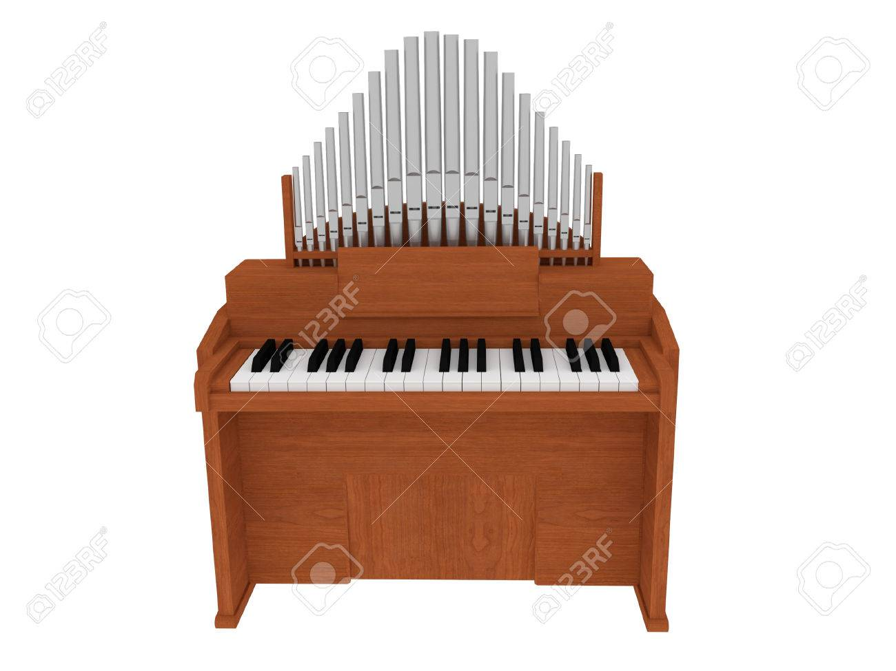

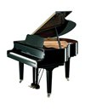
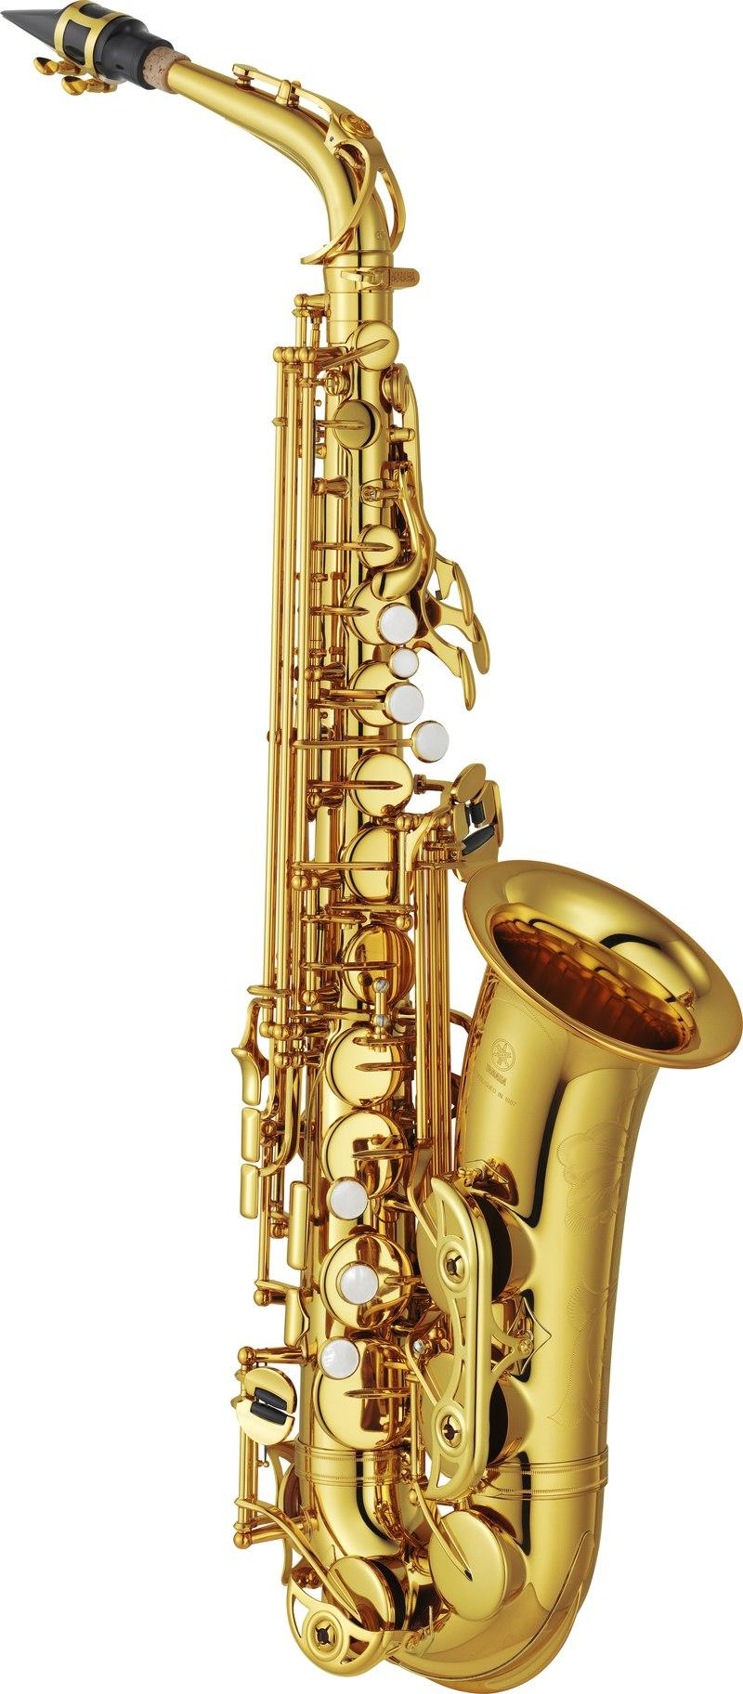
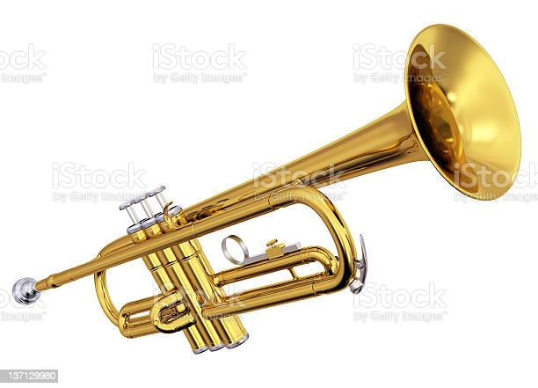
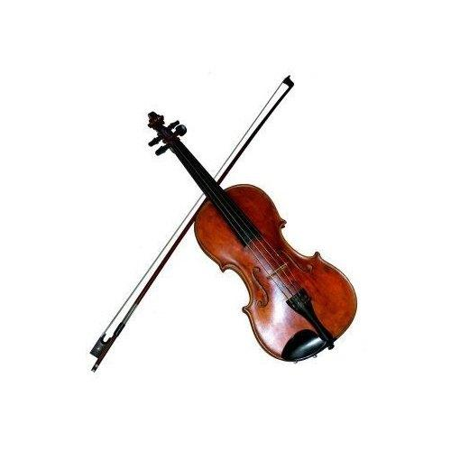
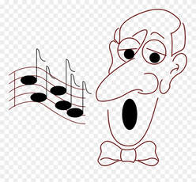
Overview
IRMAS dataset: music excerpts in WAV format
Multiclass: Instrument recognition among 11 classes
3 sec input
Training data
Test data
Dataset 1: 13410
Dataset 1: 1217
Dataset 2: 12069
Dataset 2: 1341

Slide 3
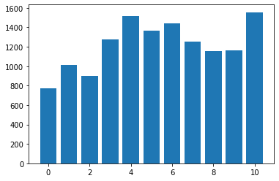
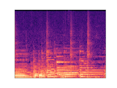
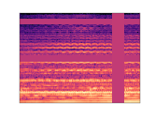
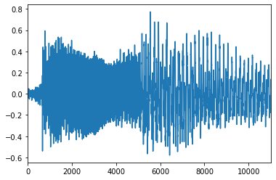
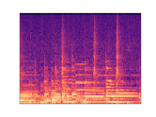
Data structure - preprocessing
Dataset partly unbalanced
Some classes are not distinguished clearly
Two preprocessing methods...
Dual channel
124*166
Frequency/time masking
Stereo
10% val
Distribution
Fs: 22.05kHz
Train/val split
Mel spectrograms
Augmentation
Input to model
Mono
15% val
Single channel
128*128
Fs: 22.05kHz
Train/val split
Mel spectrogram
1.5 sec segmentation

Slide 4
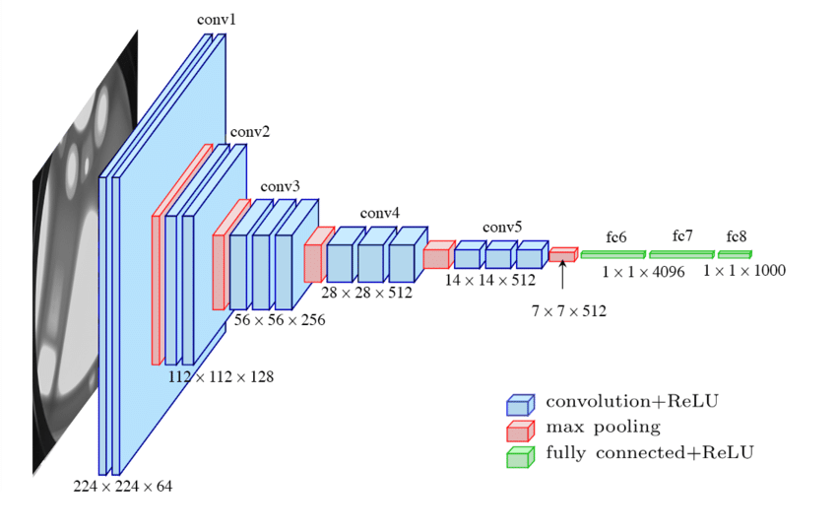
Model architectures
Flatten
...For two model architectures
11
(4*4)
(3*3)
(2*2)
Output
(2*2)
2*124*166
8*60*81
16*29*39
32*14*19
64*6*9
1*250
1*3456
1*500
BatchNorm+ReLU+Maxpool+Dropout
Custom CNN
ReLU+Dropout
...replacing FCs with custom FCs
Gradually decrease FC layer’s output with 11 nodes as final output
Replace ReLU with LeakyReLU activation function
Reduce dropout percentage
VGG16...

Slide 5
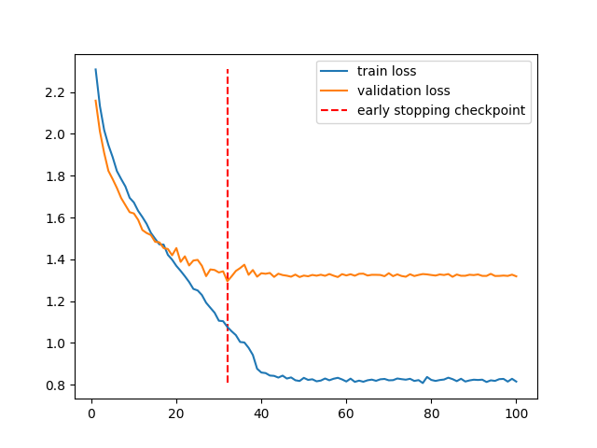
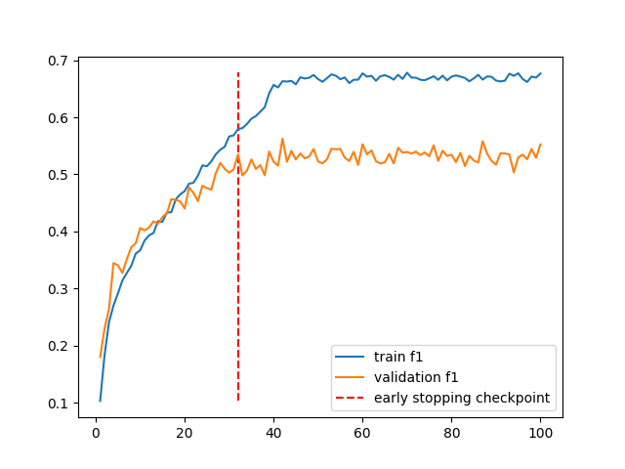
Custom CNN training
Early stopping: due to overfitting (on the loss plot)
With optimal early stopping: ~ 45% macro F1 on 20th epoch

Slide 6
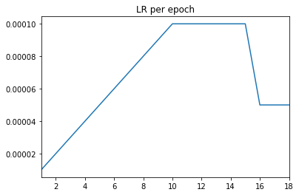
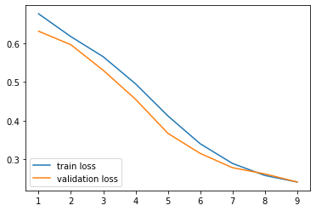
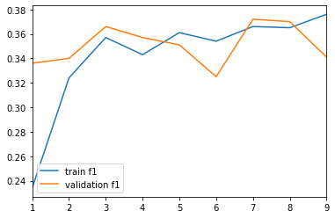
VGG16 training
Good model fit(no overfit or underfit)
Model converges on 18th epoch
Frequent learning rate adaptation for both overfit and plateau prevention
Last convolution layer plus FC layers unfrozen for first 9 epochs. Last convolution layer frozen for the rest 9 epochs

Slide 7
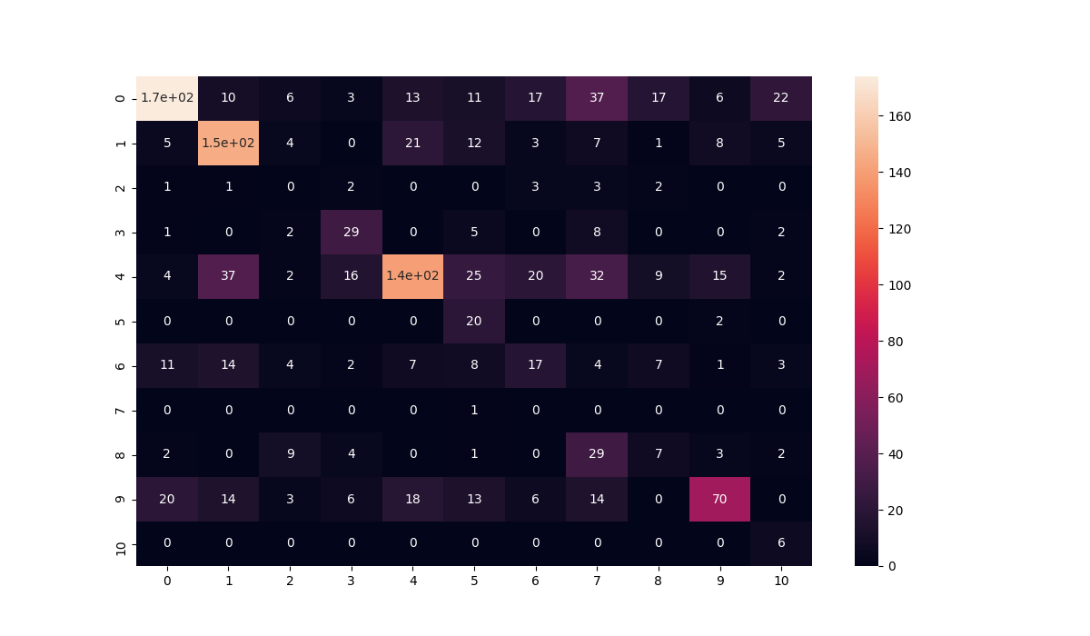
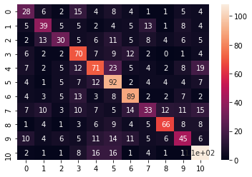
Evaluation
Test macro F1 achieved: 0.35
Test dataset created a posteriori
Highly unbalanced due to the available dataset
Test macro F1 achieved: 0.48
KFold would be useful, but resource consuming too!
Majority classes were favored

Slide 8
Conclusions
Majority classes got predicted with higher accuracy, so a larger dataset should benefit the model.
Larger variety of music genres and music instruments should help the model generalize better, achieving better classification scores and preventing overfit.
Instrument recognition retrieval in polyphonic music is in general a challenging task and deep, resource demanding architectures may perform better.

Slide 9
THANK YOU!

